Slide 1
Lending Club Data

Slide 2
Problem Statement
To understand and predict the non-payment of a loan from given data about the borrower.

Slide 3
About the Data
79 features
~ 890,000 data points
Other variants of the same data with many more features are available

Slide 4
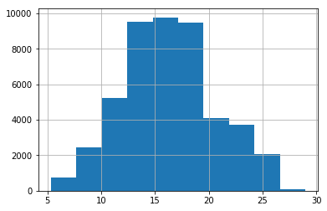
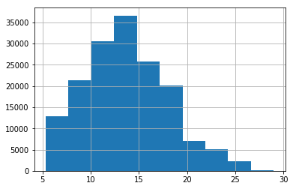
Exploratory Data Analysis
Hypothesis: Higher interest rates mean higher default rates.
Interest rate for defaulters
Interest rates for non-defaulters

Slide 5
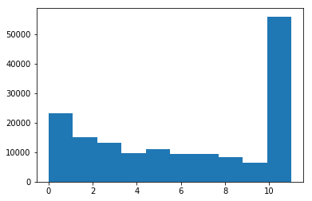
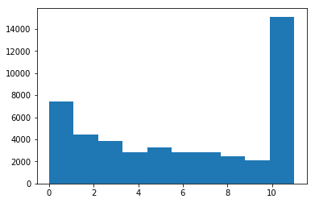
Exploratory Data Analysis
Hypothesis: Most defaulters tend to be young people.
Employed length (years) for non-defaulters
Employed length (years) for defaulters

Slide 6
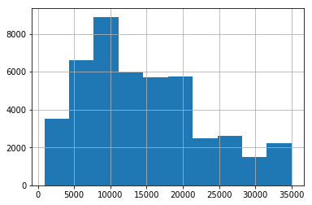
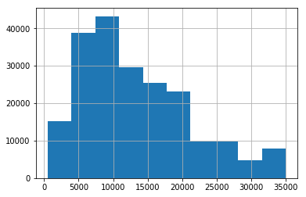
Exploratory Data Analysis
Hypothesis: Defaulters usually borrow larger amount of money compared to non-defaulters.
Loan amount ($) for defaulters
Loan amount ($) for non-defaulters

Slide 7
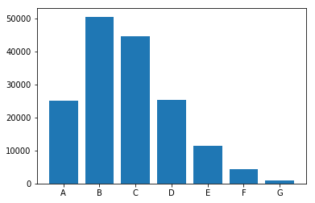
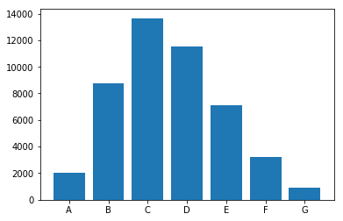
Exploratory Data Analysis
Distribution of loan grades for defaulters and non-defaulters.
Grades for non-defaulters
Grades for defaulters

Slide 8
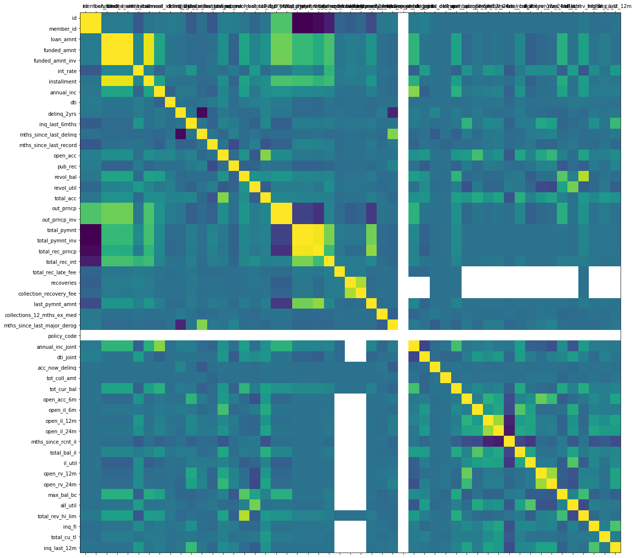
Exploratory Data Analysis

Slide 9
Data Preprocessing
Got rid of features like member_id, loan description, date etc.
Got rid of highly-correlated features.
Got rid of features which had very imbalanced distributions and did not affect the target variable like loan plan.
Got rid of all data points which had loan status as “Current” because this gives us no information in our prediction.
Got rid of all the features which had more than 30% null values.
Dummified all the categorical variables.
In the end, there were about 105 features.

Slide 10
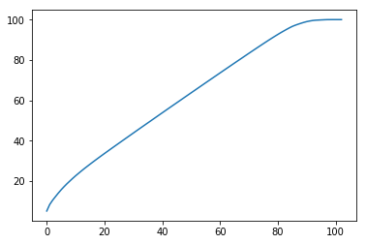
Analysis
Used PCA to extract the most important features by first normalizing the data assuming that all the features follow a normal distribution.
Cumulative PCA plot

Slide 11
Analysis
Used LGBMClassifier on the PCA transformed data.
Accuracy: ~85%.
Reasons for bad performance:
  Assumed that all features are normally distributed.
  PCA is agnostic to the target feature and hence the PCA components might not have the predictive power.

Slide 12
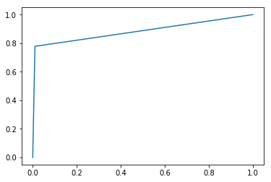
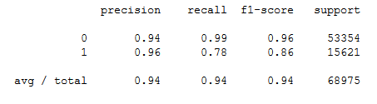
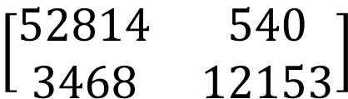
Analysis
Confusion Matrix
$$\left[\begin{matrix}52814 & 540 \\ 3468 & 12153\end{matrix}\right]$$
Linear SVC
Accuracy: ~94%
AUC: 88.4%
Cross-Validated best L2
lambda- 0.3591
ROC
Classification Report

Slide 13
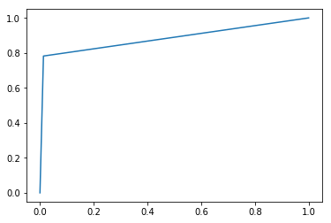
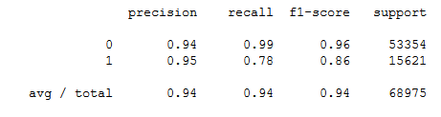
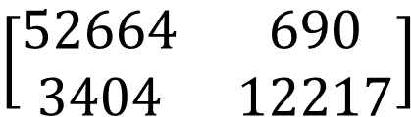
Analysis
Confusion Matrix
$$\left[\begin{matrix}52664 & 690 \\ 3404 & 12217\end{matrix}\right]$$
Logistic Regression
Accuracy: ~94%
AUC: 88.45%
No cross validation for
hyperparameters
ROC
Classification Report

Slide 14

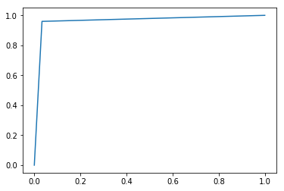
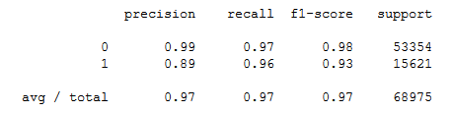
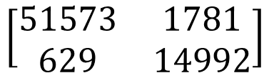
Analysis
Confusion Matrix
$$\left[\begin{matrix}51573 & 1781 \\ 629 & 14992\end{matrix}\right]$$
Random Forest
Accuracy: ~96.5%
AUC: 96.32%
No Cross Validation for
hyperparameters.
Classification Report

Slide 15
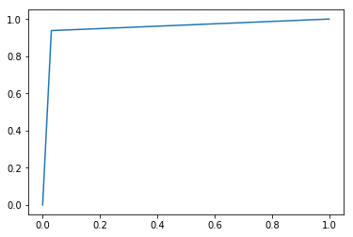
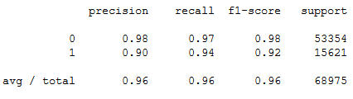
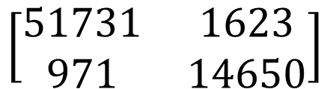
Analysis
Confusion Matrix
$$\left[\begin{matrix}51731 & 1623 \\ 971 & 14650\end{matrix}\right]$$
AdaBoost
Accuracy: ~96.3%
AUC: 95.37%
500 weak DTs
Classification Report

Slide 16
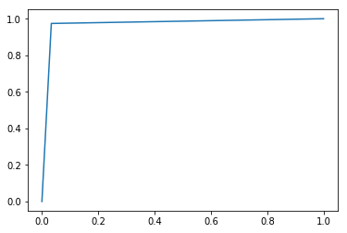
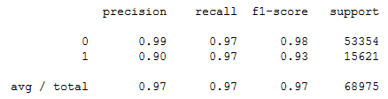
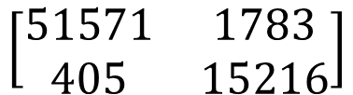
Analysis
Confusion Matrix
$$\left[\begin{matrix}51571 & 1783 \\ 405 & 15216\end{matrix}\right]$$
XGBoost
Accuracy: ~96.83%
AUC: 97.03%
300 weak DTs
Classification Report

Slide 17

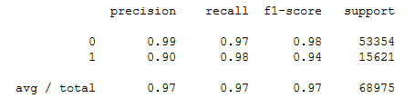
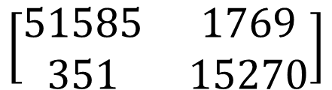
Analysis
Confusion Matrix
$$\left[\begin{matrix}51585 & 1769 \\ 351 & 15270\end{matrix}\right]$$
LightGBM
Accuracy: ~97%
AUC: 97.31%
Base model with default HPs
Classification Report

Slide 18
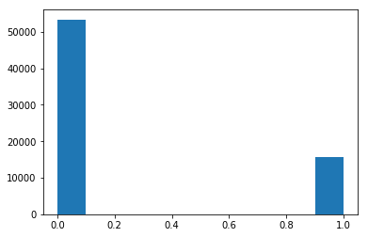

Conclusion
Histogram of test target
Histogram of best model for the target

